Slide 1
Neural Networks
This lecture is based on Michael Nielsen’s Neural Networks and Deep Learning, a free online book (with code!). Please read chapters 1-3.

Slide 2
Review: Perceptron
Perceptrons were developed in the 1950s and 1960s loosely inspired by the neuron.

Slide 3
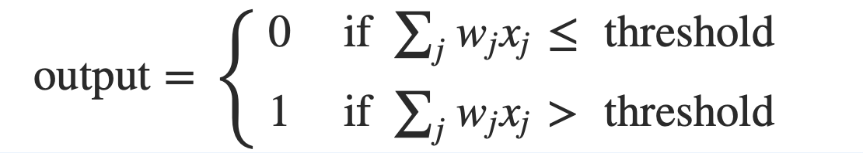
Review: Perceptron
Perceptron has inputs, x₁,x₂, .. x_{N}, and weights w₁,w₂, .. w_{N}
The perceptron outputs 0 or 1, based on the weighted sum is less than or greater than a threshold value

Slide 4
Perceptrons for decision making
We can think about the perceptron as a device that makes decisions by weighing up evidence.
Example: Suppose there’s a cheese festival in your town. You like cheese.

Slide 5
Perceptrons for decision making
You might use 3 factors to decide whether to go.
Is the weather good?
Can your loyal companion come with you?
Is the festival near public transit?
These can be the binary input values to a perceptron

Slide 6
Perceptrons for decision making
By varying weights and the threshold we get different models of decision making
Example 1: w₁= 6 w₂ = 2 w₃ = 2, threshold = 5
Example 2: w₁= 6 w₂ = 2 w₃ = 2, threshold = 3
Notes:
Example 1: You adore cheese so much you’re happy to go without your loyal companion, even if it’s hard to get to, but you hate bad weather
Example 2: Lower the threshold to 3. Then the perceptron would decide that you should go to the festival whenever the weather was good or when both the festival was near public transit and your boyfriend or girlfriend was willing to join you.
Obviously, the perceptron isn't a complete model of human decision-making! But what the example illustrates is how a perceptron can weigh up different kinds of evidence in order to make decisions

Slide 7
Perceptrons for decision making
A complex network of perceptrons could make quite subtle decisions:
Layer 3
Complex decisions can be made by the perceptron in the third layer
Layer 1
Layer 2
1st layer makes 3 simple decisions by weighing the input evidence
2nd layer makes a decision by weighing up the results from the 1st layer of decision-making
Notes:
In this network, the first column of perceptrons - what we'll call the first layer of perceptrons - is making three very simple decisions, by weighing the input evidence. What about the perceptrons in the second layer? Each of those perceptrons is making a decision by weighing up the results from the first layer of decision-making. In this way a perceptron in the second layer can make a decision at a more complex and more abstract level than perceptrons in the first layer. And even more complex decisions can be made by the perceptron in the third layer. In this way, a many-layer network of perceptrons can engage in sophisticated decision making.

Slide 8
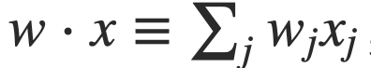
Weights, bias and dot products
Two notational changes simplify the way that perceptrons are described.
The first change is to replace the weighted sum as a dot product
The second change is to move the threshold to the other side of the inequality, and to replace it by a bias, b≡−threshold
Notes:
You can think of the bias as a measure of how easy it is to get the perceptron to output a 1. Or to put it in more biological terms, the bias is a measure of how easy it is to get the perceptron to fire. For a perceptron with a really big bias, it's extremely easy for the perceptron to output a 1. But if the bias is very negative, then it's difficult for the perceptron to output a 1.

Slide 9
Decision making OR logical functions
Perceptrons can be used is to compute logical functions like AND, OR and NAND
Example:
Input | Weighted sum | Output
00 | -2*0 + -2*0 +3 = 3 | 1
10 or 01 | -2*1 + -2*0 +3 = 1 | 1
11 | -2*1 + -2*1 +3 = -1 | 0
weights
bias
Notes:
So far, we have thought of perceptrons as a method for weighing evidence to make decisions. Another way perceptrons can be used is to compute the elementary logical functions we usually think of as underlying computation, functions such as AND, OR, and NAND. For example, suppose we have a perceptron with two inputs, each with weight−2, and an overall bias of 3.
What logical operator does this represent? This is a NAND gate!

Slide 10
Logical functions
Networks of perceptrons to compute any logical function
We can build any computation up out of NAND gates.
For example, a circuit which adds two bits x₁ and x₂
All unlabeled weights are -2, all biases =3.
Notes:
we can use networks of perceptrons to compute any logical function at all. The reason is that the NAND gate is universal for computation, that is, we can build any computation up out of NAND gates.
The NAND example shows that we can use perceptrons to compute simple logical functions. In fact, we can use networks of perceptrons to compute any logical function at all. The reason is that the NAND gate is universal for computation, that is, we can build any computation up out of NAND gates. For example, we can use NAND gates to build a circuit which adds two bits, x1 and x2. This requires computing the bitwise sum, x1⊕x2x1⊕x2, as well as a carry bit which is set to 1 when both x1 and x2 are 1, i.e., the carry bit is just the bitwise product x1x2:

Slide 11
Power of Perceptrons
Networks of Perceptrons are universal for computation, like NAND gates
Perceptrons can be as powerful as any other computing device!
We can devise learning algorithms to automatically tune the weights and biases of a network of artificial neurons
Instead of laying out a circuit of NAND and other gates, neural networks can simply learn to solve problems
Notes:
The adder example demonstrates how a network of perceptrons can be used to simulate a circuit containing many NAND gates. And because NAND gates are universal for computation, it follows that perceptrons are also universal for computation.
The computational universality of perceptrons is simultaneously reassuring and disappointing. It's reassuring because it tells us that networks of perceptrons can be as powerful as any other computing device. But it's also disappointing, because it makes it seem as though perceptrons are merely a new type of NAND gate. That's hardly big news!
However, the situation is better than this view suggests. It turns out that we can devise learning algorithms which can automatically tune the weights and biases of a network of artificial neurons. This tuning happens in response to external stimuli, without direct intervention by a programmer. These learning algorithms enable us to use artificial neurons in a way which is radically different to conventional logic gates. Instead of explicitly laying out a circuit of NAND and other gates, our neural networks can simply learn to solve problems, sometimes problems where it would be extremely difficult to directly design a conventional circuit.

Slide 12
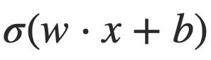
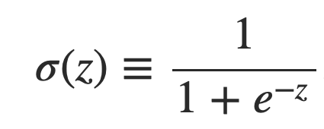
Sigmoid neurons
Problem: a small change in the weights or bias of any single perceptron in the network can causes the output to completely flip from 0 to 1.
Solution: sigmoid neuron
Perceptron
Sigmoid neuron
output =
Output is no longer just 1 or 0.
Same weights and bias as perceptron
Sigmoid function:
Inputs: any real-valued number
Notes:
That flip may then cause the behavior of the whole network to change in a very complicated way.

Slide 13
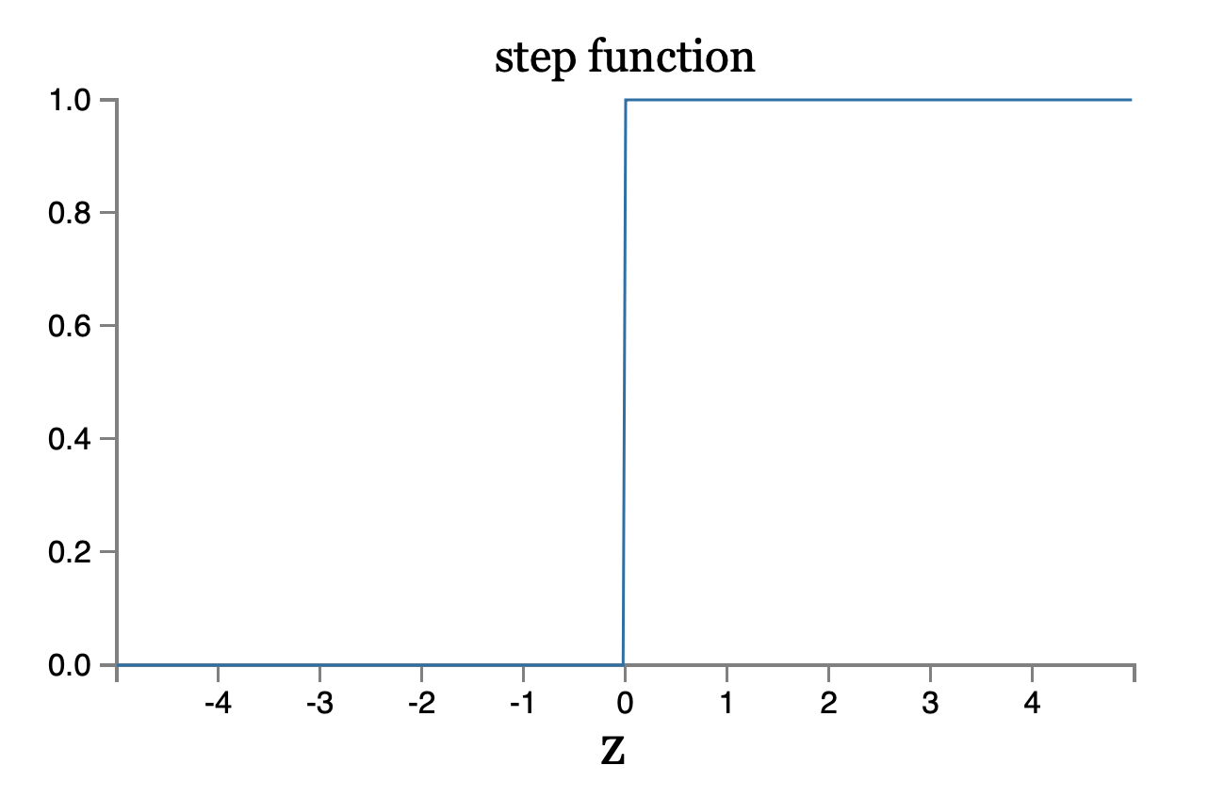
Perceptron

Slide 14
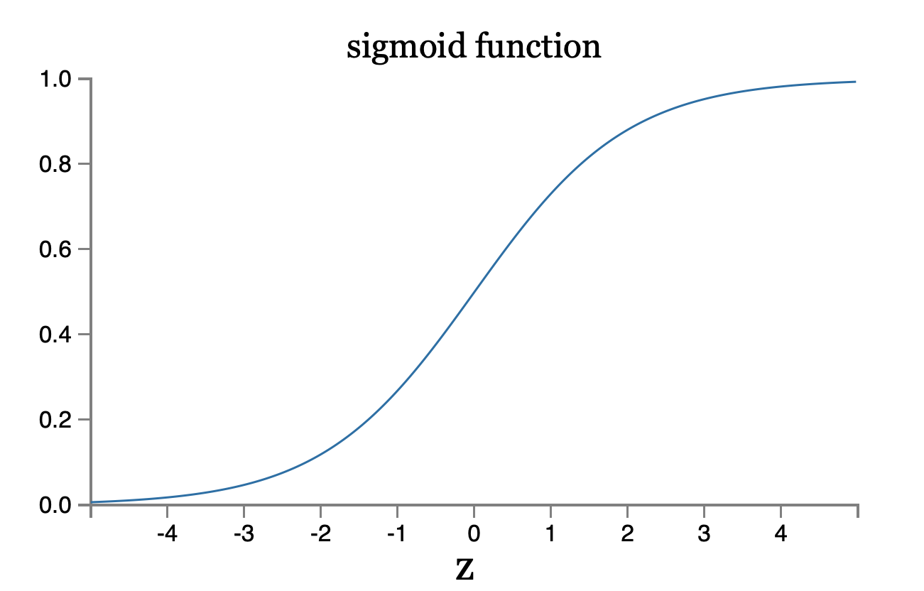
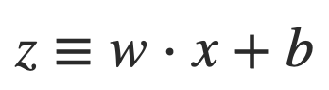
Sigmoid neurons
1
Notes:
By using the actual σ function we get a smoothed out perceptron.
How should we interpret the output from a sigmoid neuron? They don’t just output 0 or 1, but can have values like 0.173…0.689…
This can be useful if we want to use the output value to represent the average intensity of the pixels in an image input to a neural network.
But sometimes it can be a nuisance. Suppose we want the output from the network to indicate either "the input image is a 9" or "the input image is not a 9".
Obviously, it'd be easiest to do this if the output was a 0 or a 1, as in a perceptron.
But in practice we can set up a convention to deal with this by deciding to interpret any output of at least 0.5 as indicating a "9", and any output less than that as indicating "not a 9".

Slide 15
Sigmoid neurons are better for training
Notes:
With percetrons there is a problem: a small change in the weights or bias of any single perceptron in the network can causes the output to completely flip from 0 to 1.
The smoothness of σ means that small changes jΔwj in the weights and Δb in the bias will produce a small change Δoutput in the output from the neuron

Slide 16
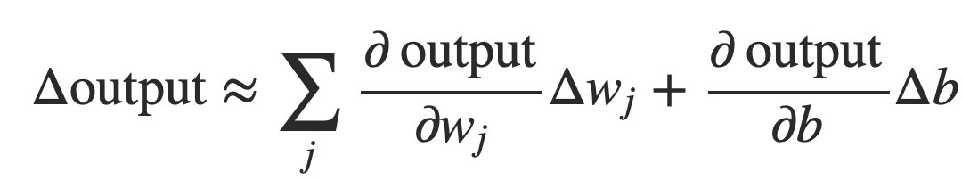
Smoothness is crucial
Smoothness of σ means that small changes in the weights w_{j} and in the bias b will produce a small change the output from the neuron
Δoutput is a linear function of the changes Δwj and Δb
This makes it easy to choose small changes in the weights and biases to achieve any desired small change in the output
Notes:
where the sum is over all the weights, wj and bias b and ∂output/∂wj is the partial derivative of the output with respect to wj. And ∂output/∂b denote partial derivative of the output with respect b.
This linearity makes it easy to choose small changes in the weights and biases to achieve any desired small change in the output. So while sigmoid neurons have much of the same qualitative behaviour as perceptrons, they make it much easier to figure out how changing the weights and biases will change the output.

Slide 17
Neural Net Architecture
Notes:
for historical reasons, such multiple layer networks are sometimes called multilayer perceptrons orMLPs, despite being made up of sigmoid neurons, not perceptrons.
While the design of the input and output layers of a neural network is often straightforward, there can be quite an art to the design of the hidden layers. This is called a feedforward neural network. There are other models of artificial neural networks in which feedback loops are possible. These models are called recurrent neural networks.

Slide 18
Neural Net Architecture
28x28=784 pixels
Notes:
The design of the input and output layers in a network is often straightforward. For digit classification if the image is a 28x28 greyscale image, then we have 784=28×28 neurons, with the intensities between 0 and 1. The output layer will contain just a single neuron, with output values of less than 0.5 indicating ”not a 9”.
The second layer of the network is a hidden layer. The example shown illustrates a small hidden layer, containing just n=15 neurons. We can vary this number.
The output layer of the network contains 10 neurons. We figure out which neuron has the highest activation value.

Slide 19
Neural Net Architecture
28x28=784 pixels

Slide 20
Neural Net Architecture
28x28=784 pixels
0

Slide 21
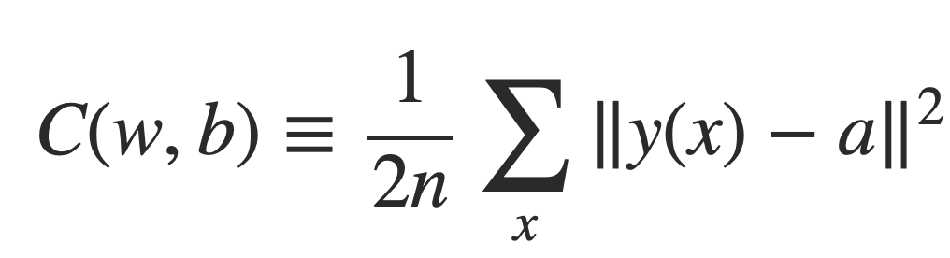
Cost Function
AKA Loss function or Objective function
Here’s a common one called “Mean Squared Error”
Cost
weights, biases
n = number of training examples
y(x) = correct answer
a = vector of system’s outputs

Slide 22
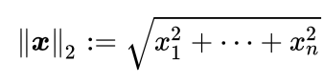
Cost Function
AKA Loss function or Objective function
Here’s a common one called “Mean Squared Error”
 | y(x) | a
0 | 0 | 0.01
1 | 0 | 0.001
2 | 0
3 | 0
4 | 0
5 | 0
6 | 1
7 | 0
8 | 0
9 | 0
Cost
weights, biases
n = number of training examples
y(x) = correct answer
a = vector of system’s outputs
Notes:
C(w,b)≈0, precisely when y(x) is approximately equal to the output, a, for all training inputs, x.
So the aim of our training algorithm will be to minimize the cost C(w,b)C(w,b) as a function of the weights and biases.
Why introduce MSE? After all, aren't we primarily interested in the number of images correctly classified by the network? Why not try to maximize that number directly? The problem with that is that the number of images correctly classified is not a smooth function of the weights and biases in the network. For the most part, making small changes to the weights and biases won't cause any change at all in the number of training images classified correctly.
https://en.wikipedia.org/wiki/Norm_(mathematics)

Slide 23
Minimize the loss function
Notes:
Imagine C as a function of just two variables, which we'll call v1 and v2.
A general function, C, may be a complicated function of many variables.
One way is to use calculus to try to find the minimum analytically. We could compute derivatives and then try using them to find places where C is a max/min. With some luck that might work when C is a function of just one or a few variables. But it'll turn into a nightmare when we have many more variables. And for neural networks we'll often want far more variables - the biggest neural networks have cost functions which depend on billions of weights and biases in an extremely complicated way. Using calculus to minimize that just won't work!
Instead, we’re going to use an algorithm that computes derivatives (and perhaps some second derivatives) of C. - those derivatives would tell us everything we need to know about the local "shape" of the valley

Slide 24
Gradient Descent
Notes:
https://upload.wikimedia.org/wikipedia/commons/8/84/Ski_Famille_-_Family_Ski_Holidays.jpg

Slide 25
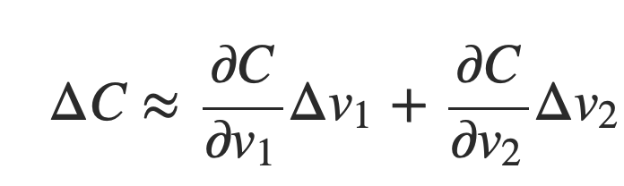
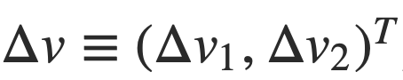
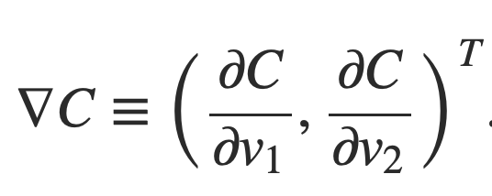
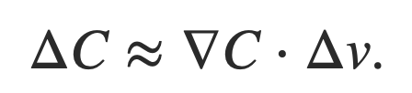
Minimize the loss function
(we want to minimize this)
vector of changes in v
gradient vector
Notes:
Let's think about what happens when we move the ball a small amount Δv1 in the v1 direction, and a small amount Δv2 in the v2 direction. Calculus tells us that C changes as follows: the derivative of C wrt v1, and the derivative of C wrt v2.
We're going to find a way of choosing Δv1 and Δv2 so as to make ΔC negative
nabla symbol ∇ also called Del.

Slide 26
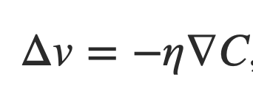
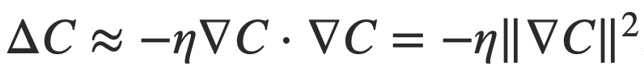
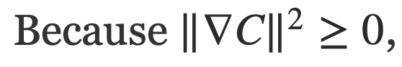
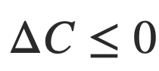
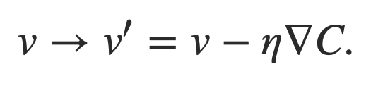
Minimize the loss function
η is a small, positive parameter
known as the learning rate
C will always decrease, if we change
v according to Δv=−η∇C
Notes:
η is eta

Slide 27
Minimize the loss function
η is a small, positive parameter
known as the learning rate
C will always decrease, if we change
v according to Δv=−η∇C
Notes:
η is eta
where ηη is a small, positive parameter (known as the learning rate). Then ΔC≈∇C⋅Δv tells us that ΔC≈−η∇C⋅∇C=−η‖∇C‖2. Because ‖∇C‖2≥0, this guarantees that ΔC≤0, i.e., C will always decrease, never increase, if we change v according to Δv=−η∇C. This is exactly the property we wanted!
And so we'll take Δv=−η∇C to define the "law of motion" for the ball in our gradient descent algorithm.

Slide 28
Minimize the loss function
Notes:
Then we'll use this update rule again, to make another move. If we keep doing this, over and over, we'll keep decreasing CC until - we hope - we reach a global minimum.
the way the gradient descent algorithm works is to repeatedly compute the gradient ∇C, and then to move in the opposite direction, "falling down" the slope of the valley.
Notice that with this rule gradient descent doesn't reproduce real physical motion. In real life a ball has momentum, and that momentum may allow it to roll across the slope, or even (momentarily) roll uphill. It's only after the effects of friction set in that the ball is guaranteed to roll down into the valley. By contrast, our rule for choosing Δv just says "go down, right now". That's still a pretty good rule for finding the minimum!
To make gradient descent work correctly, we need to choose the learning rate ηη to be small enough that Equation (9) is a good approximation. If we don't, we might end up with ΔC>0ΔC>0, which obviously would not be good! At the same time, we don't want ηη to be too small, since that will make the changes ΔvΔv tiny, and thus the gradient descent algorithm will work very slowly.
I've explained gradient descent when CC is a function of just two variables. But, in fact, everything works just as well even when CC is a function of many more variables

Slide 29
Sigmoid neurons are better for training
Notes:
With percetrons there is a problem: a small change in the weights or bias of any single perceptron in the network can causes the output to completely flip from 0 to 1.
The smoothness of σ means that small changes jΔwj in the weights and Δb in the bias will produce a small change Δoutput in the output from the neuron

Slide 30
Smoothness is crucial
Smoothness of σ means that small changes in the weights w_{j} and in the bias b will produce a small change the output from the neuron
Δoutput is a linear function of the changes Δwj and Δb
This makes it easy to choose small changes in the weights and biases to achieve any desired small change in the output
Notes:
where the sum is over all the weights, wj and bias b and ∂output/∂wj is the partial derivative of the output with respect to wj. And ∂output/∂b denote partial derivative of the output with respect b.
This linearity makes it easy to choose small changes in the weights and biases to achieve any desired small change in the output. So while sigmoid neurons have much of the same qualitative behaviour as perceptrons, they make it much easier to figure out how changing the weights and biases will change the output.

Slide 31
Neural Net Architecture
Notes:
for historical reasons, such multiple layer networks are sometimes called multilayer perceptrons orMLPs, despite being made up of sigmoid neurons, not perceptrons.
While the design of the input and output layers of a neural network is often straightforward, there can be quite an art to the design of the hidden layers. This is called a feedforward neural network. There are other models of artificial neural networks in which feedback loops are possible. These models are called recurrent neural networks.

Slide 32
Neural Net Architecture
28x28=784 pixels
Notes:
The design of the input and output layers in a network is often straightforward. For digit classification if the image is a 28x28 greyscale image, then we have 784=28×28 neurons, with the intensities between 0 and 1. The output layer will contain just a single neuron, with output values of less than 0.5 indicating ”not a 9”.
The second layer of the network is a hidden layer. The example shown illustrates a small hidden layer, containing just n=15 neurons. We can vary this number.
The output layer of the network contains 10 neurons. We figure out which neuron has the highest activation value.

Slide 33
Neural Net Architecture
28x28=784 pixels

Slide 34
Neural Net Architecture
28x28=784 pixels
0

Slide 35
Cost Function
AKA Loss function or Objective function
Here’s a common one called “Mean Squared Error”
Cost
weights, biases
n = number of training examples
y(x) = correct answer
a = vector of system’s outputs

Slide 36
Cost Function
AKA Loss function or Objective function
Here’s a common one called “Mean Squared Error”
 | y(x) | a
0 | 0 | 0.01
1 | 0 | 0.001
2 | 0
3 | 0
4 | 0
5 | 0
6 | 1
7 | 0
8 | 0
9 | 0
Cost
weights, biases
n = number of training examples
y(x) = correct answer
a = vector of system’s outputs
Notes:
C(w,b)≈0, precisely when y(x) is approximately equal to the output, a, for all training inputs, x.
So the aim of our training algorithm will be to minimize the cost C(w,b)C(w,b) as a function of the weights and biases.
Why introduce MSE? After all, aren't we primarily interested in the number of images correctly classified by the network? Why not try to maximize that number directly? The problem with that is that the number of images correctly classified is not a smooth function of the weights and biases in the network. For the most part, making small changes to the weights and biases won't cause any change at all in the number of training images classified correctly.
https://en.wikipedia.org/wiki/Norm_(mathematics)

Slide 37
Minimize the loss function
Notes:
Imagine C as a function of just two variables, which we'll call v1 and v2.
A general function, C, may be a complicated function of many variables.
One way is to use calculus to try to find the minimum analytically. We could compute derivatives and then try using them to find places where C is a max/min. With some luck that might work when C is a function of just one or a few variables. But it'll turn into a nightmare when we have many more variables. And for neural networks we'll often want far more variables - the biggest neural networks have cost functions which depend on billions of weights and biases in an extremely complicated way. Using calculus to minimize that just won't work!
Instead, we’re going to use an algorithm that computes derivatives (and perhaps some second derivatives) of C. - those derivatives would tell us everything we need to know about the local "shape" of the valley

Slide 38
Gradient Descent
Notes:
https://upload.wikimedia.org/wikipedia/commons/8/84/Ski_Famille_-_Family_Ski_Holidays.jpg

Slide 39
Hill Climbing
Notes:
https://upload.wikimedia.org/wikipedia/commons/8/84/Ski_Famille_-_Family_Ski_Holidays.jpg

Slide 40
Minimize the loss function
(we want to minimize this)
vector of changes in v
gradient vector
Notes:
Let's think about what happens when we move the ball a small amount Δv1 in the v1 direction, and a small amount Δv2 in the v2 direction. Calculus tells us that C changes as follows: the derivative of C wrt v1, and the derivative of C wrt v2.
We're going to find a way of choosing Δv1 and Δv2 so as to make ΔC negative
nabla symbol ∇ also called Del.

Slide 41
Minimize the loss function
η is a small, positive parameter
known as the learning rate
C will always decrease, if we change
v according to Δv=−η∇C
Notes:
η is eta
where ηη is a small, positive parameter (known as the learning rate). Then ΔC≈∇C⋅Δv tells us that ΔC≈−η∇C⋅∇C=−η‖∇C‖2. Because ‖∇C‖2≥0, this guarantees that ΔC≤0, i.e., C will always decrease, never increase, if we change v according to Δv=−η∇C. This is exactly the property we wanted!
And so we'll take Δv=−η∇C to define the "law of motion" for the ball in our gradient descent algorithm.

Slide 42
Minimize the loss function
Notes:
Then we'll use this update rule again, to make another move. If we keep doing this, over and over, we'll keep decreasing CC until - we hope - we reach a global minimum.
the way the gradient descent algorithm works is to repeatedly compute the gradient ∇C, and then to move in the opposite direction, "falling down" the slope of the valley.
Notice that with this rule gradient descent doesn't reproduce real physical motion. In real life a ball has momentum, and that momentum may allow it to roll across the slope, or even (momentarily) roll uphill. It's only after the effects of friction set in that the ball is guaranteed to roll down into the valley. By contrast, our rule for choosing Δv just says "go down, right now". That's still a pretty good rule for finding the minimum!
To make gradient descent work correctly, we need to choose the learning rate ηη to be small enough that Equation (9) is a good approximation. If we don't, we might end up with ΔC>0ΔC>0, which obviously would not be good! At the same time, we don't want ηη to be too small, since that will make the changes ΔvΔv tiny, and thus the gradient descent algorithm will work very slowly.
I've explained gradient descent when CC is a function of just two variables. But, in fact, everything works just as well even when CC is a function of many more variables

Slide 43
Backpropagation
Notes:
The gradient descent algorithm can learn their weights and biases. However, it doesn’t tell us how to compute the gradient of the cost function.
The backpropagation algorithm was originally introduced in the 1970s, but its importance wasn't fully appreciated until a famous 1986 paper by David Rumelhart, Geoffrey Hinton, and Ronald Williams. That paper describes several neural networks where backpropagation works far faster than earlier approaches to learning, making it possible to use neural nets to solve problems which had previously been insoluble.
At the heart of backpropagation is an expression for the partial derivative ∂C/∂w of the cost function C with respect to any weight w (or bias b) in the network.
The expression tells us how quickly the cost changes when we change the weights and biases. And while the expression is somewhat complex, it also has a beauty to it, with each element having a natural, intuitive interpretation. And so backpropagation isn't just a fast algorithm for learning. It actually gives us detailed insights into how changing the weights and biases changes the overall behaviour of the network.
http://www.cs.toronto.edu/~hinton/absps/naturebp.pdf

Slide 44
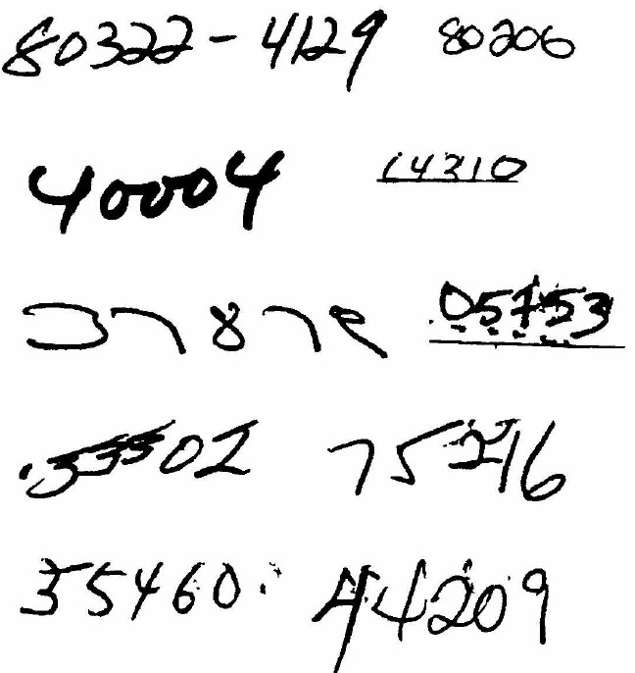
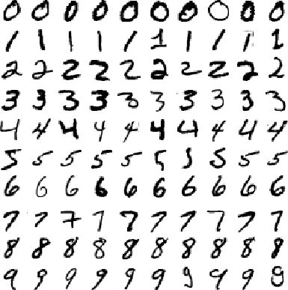
Digit classification
Zip codes
Backpropagation applied to handwritten zip code recognition, Lecun et al., 1989
Notes:
While our neural network gives impressive performance, that performance is somewhat mysterious. The weights and biases in the network were discovered automatically. And that means we don't immediately have an explanation of how the network does what it does. Can we find some way to understand the principles by which our network is classifying handwritten digits? And, given such principles, can we do better?
To put these questions more starkly, suppose that a few decades hence neural networks lead to artificial intelligence (AI). Will we understand how such intelligent networks work? Perhaps the networks will be opaque to us, with weights and biases we don't understand, because they've been learned automatically. In the early days of AI research people hoped that the effort to build an AI would also help us understand the principles behind intelligence and, maybe, the functioning of the human brain. But perhaps the outcome will be that we end up understanding neither the brain nor how artificial intelligence works!

Slide 45
Toward Deep Learning
Which of the following contain a face?
Can we approach the problem the same way we do for digits?
Notes:
let's think back to the interpretation of artificial neurons as a means of weighing evidence. Suppose we want to determine whether an image shows a human face or not:
We could attack this problem the same way we attacked handwriting recognition - by using the pixels in the image as input to a neural network, with the output from the network a single neuron indicating either "Yes, it's a face" or "No, it's not a face".

Slide 46
Toward Deep Learning
Notes:
Let's suppose we do this, but that we're not using a learning algorithm. Instead, we're going to try to design a network by hand, choosing appropriate weights and biases. How might we go about it? Forgetting neural networks entirely for the moment, a heuristic we could use is to decompose the problem into sub-problems: does the image have an eye in the top left? Does it have an eye in the top right? Does it have a nose in the middle? Does it have a mouth in the bottom middle? Is there hair on top? And so on.
If the answers to several of these questions are "yes", or even just "probably yes", then we'd conclude that the image is likely to be a face. Conversely, if the answers to most of the questions are "no", then the image probably isn't a face.
the heuristic suggests that if we can solve the sub-problems using neural networks, then perhaps we can build a neural network for face-detection, by combining the networks for the sub-problems. Here's a possible architecture, with rectangles denoting the sub-networks.

Slide 47
Toward Deep Learning
Notes:
It's also plausible that the sub-networks can be decomposed. Suppose we're considering the question: "Is there an eye in the top left?" This can be decomposed into questions such as: "Is there an eyebrow?"; "Are there eyelashes?"; "Is there an iris?"; and so on. Of course, these questions should really include positional information, as well - "Is the eyebrow in the top left, and above the iris?", that kind of thing - but let's keep it simple. The network to answer the question "Is there an eye in the top left?" can now be decomposed.

Slide 48
Notes:
Those questions too can be broken down, further and further through multiple layers. Ultimately, we'll be working with sub-networks that answer questions so simple they can easily be answered at the level of single pixels. Those questions might, for example, be about the presence or absence of very simple shapes at particular points in the image. Such questions can be answered by single neurons connected to the raw pixels in the image.

Slide 49
Notes:
The end result is a network which breaks down a very complicated question - does this image show a face or not - into very simple questions answerable at the level of single pixels. It does this through a series of many layers, with early layers answering very simple and specific questions about the input image, and later layers building up a hierarchy of ever more complex and abstract concepts. Networks with this kind of many-layer structure - two or more hidden layers - are called deep neural networks.
The end result is a network which breaks down a very complicated question - does this image show a face or not - into very simple questions answerable at the level of single pixels. It does this through a series of many layers, with early layers answering very simple and specific questions about the input image, and later layers building up a hierarchy of ever more complex and abstract concepts. Networks with this kind of many-layer structure - two or more hidden layers - are called deep neural networks.

Slide 50

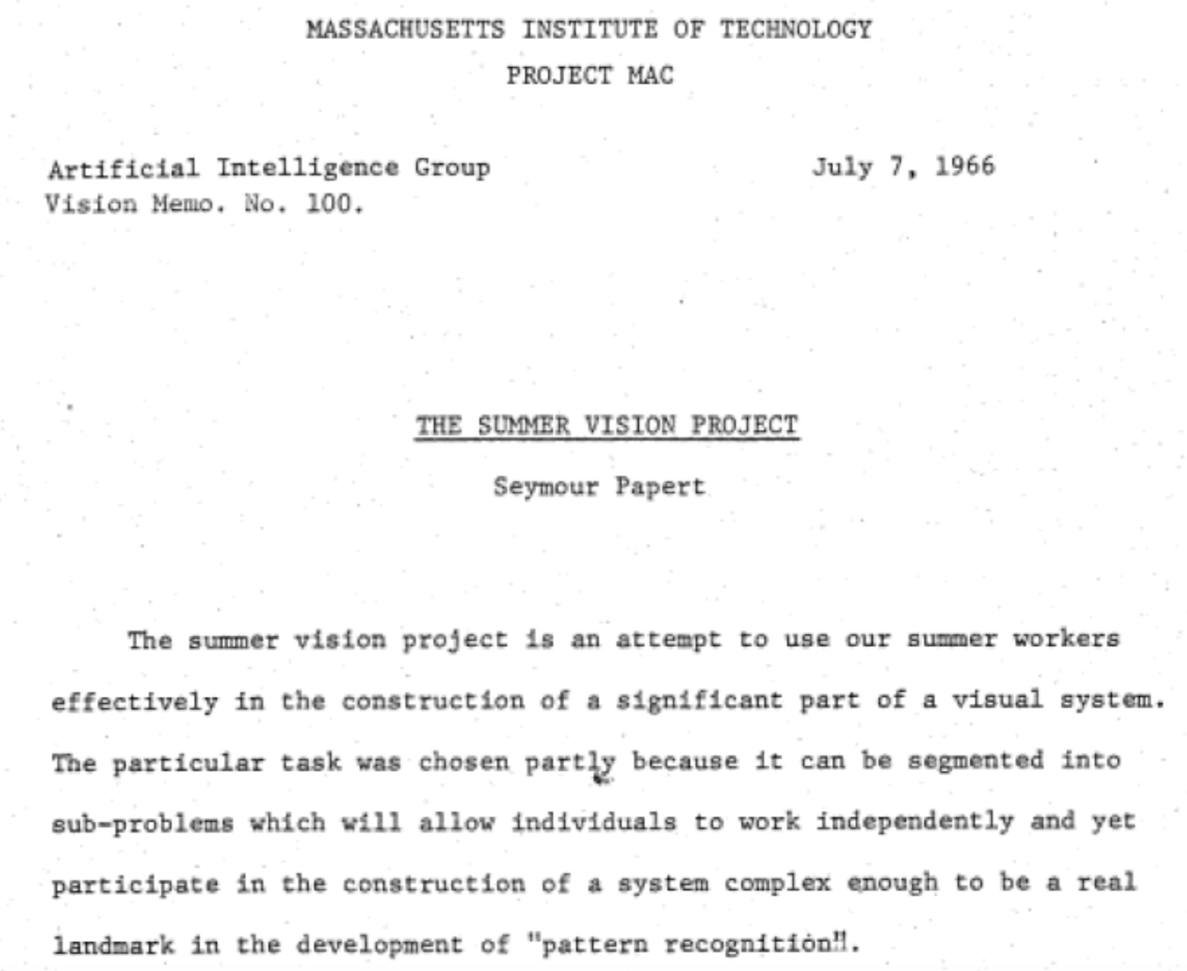
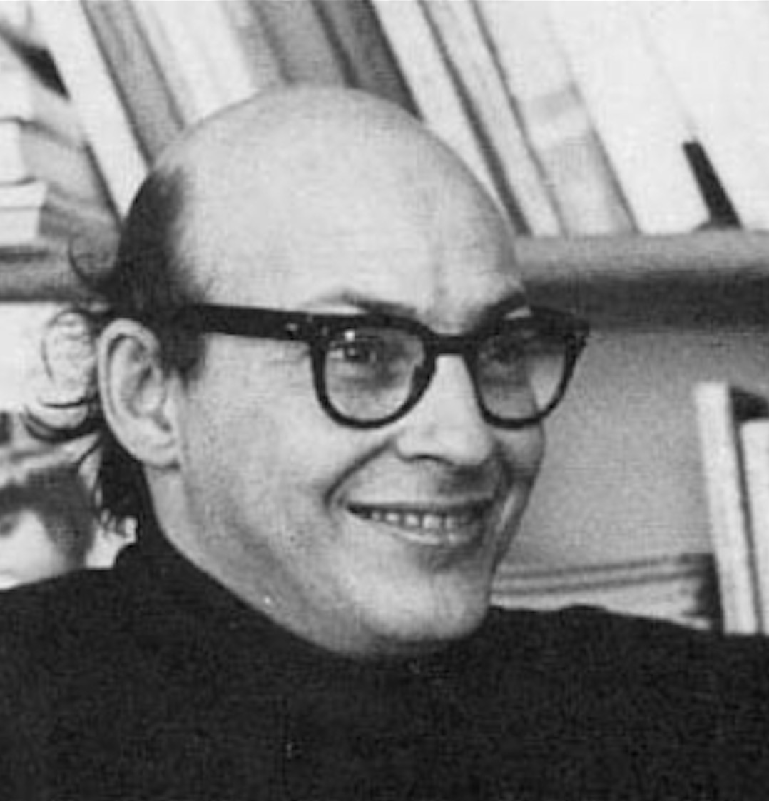
1966
“Connect a television camera to a computer and get the machine to describe what it sees.”
Marvin Minsky Turing award, 1969

Slide 51

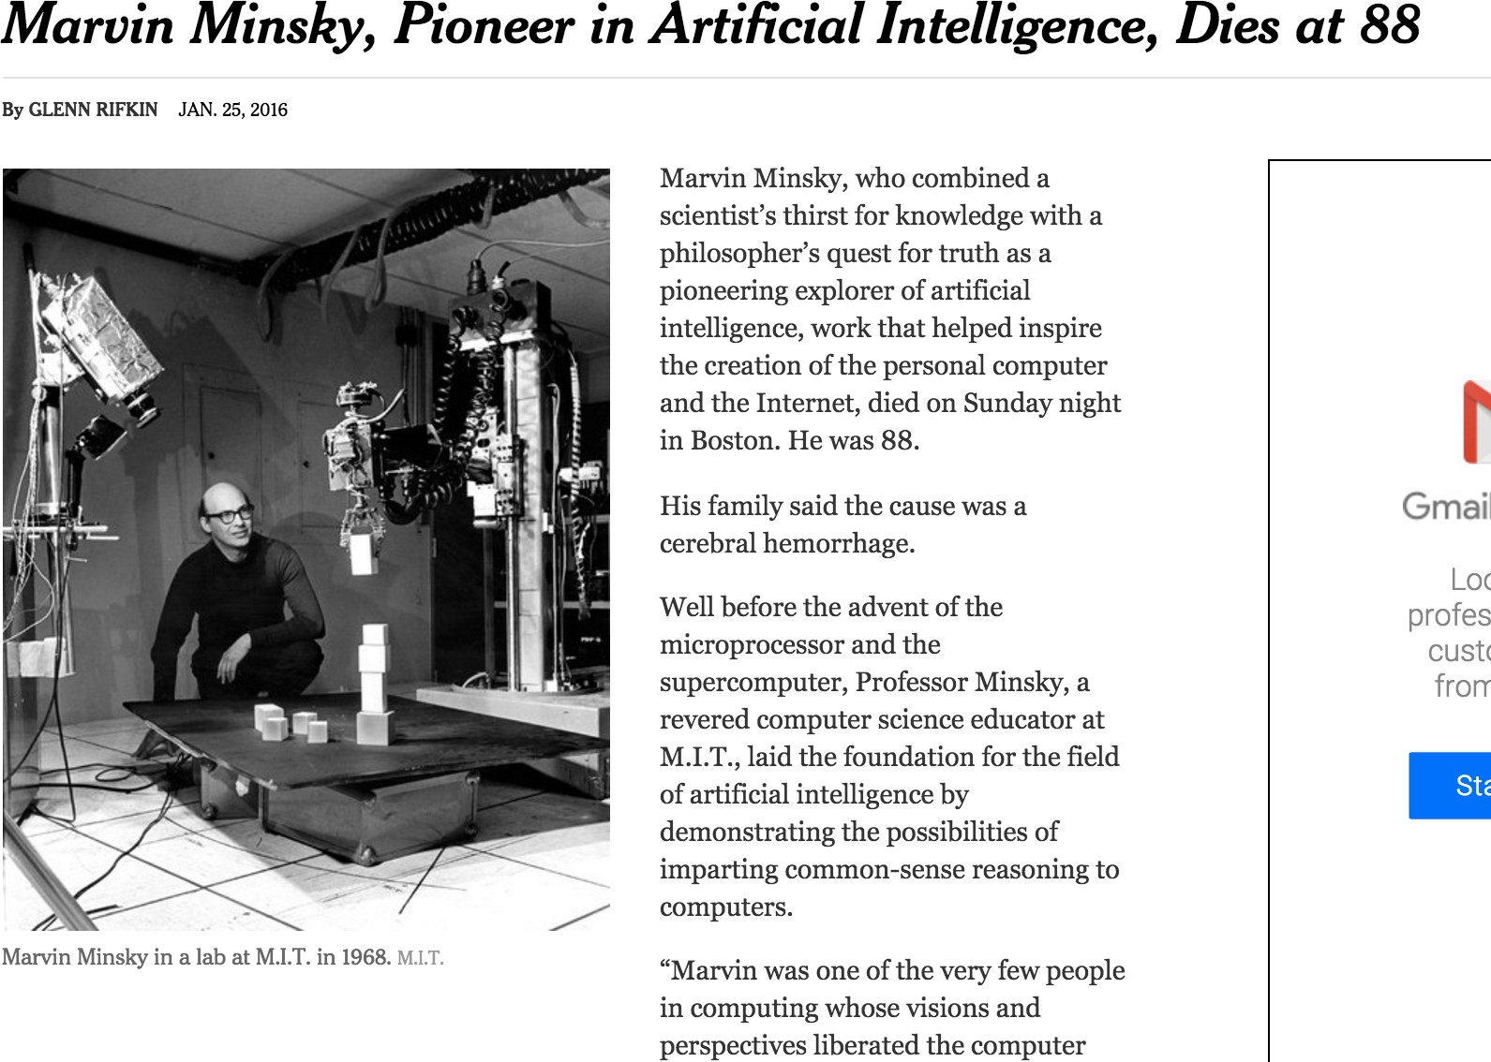

Slide 52
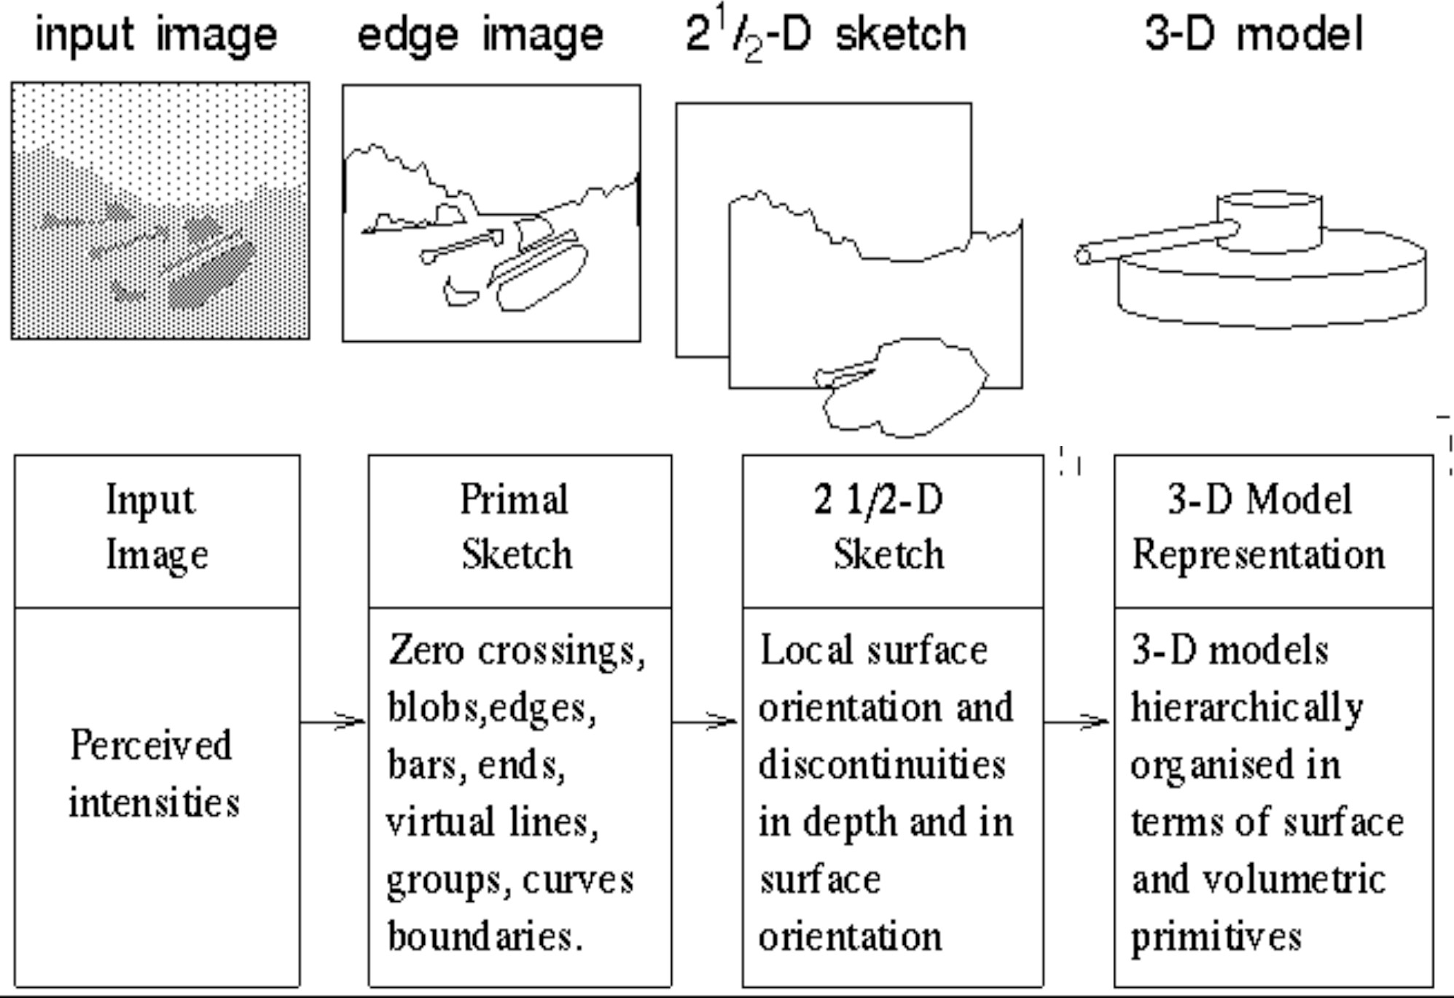
Stages of Visual Representation, David Marr, 1970

Slide 53
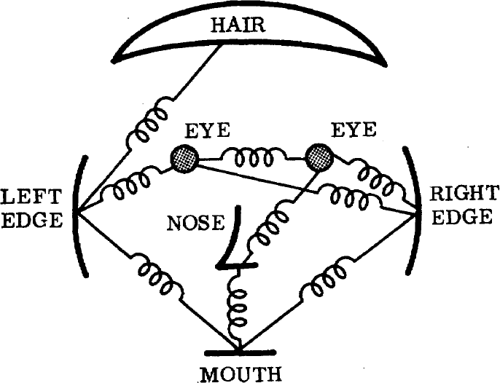
1973
The constellation model
The representation and matching of pictorial structures, Fischler and Elschlager, 1973

Slide 54
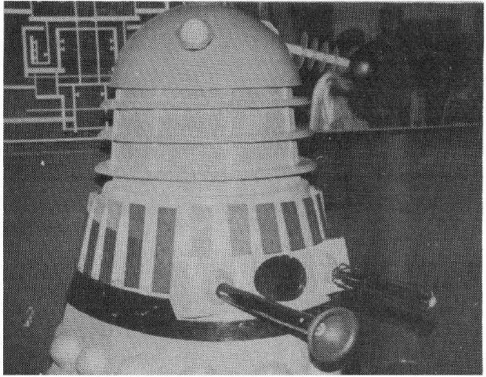
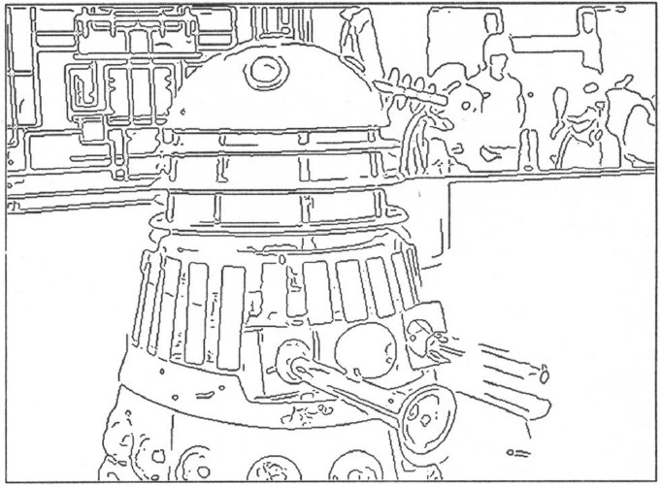
1980’s
AI winter…
…back to basics
A Computational Approach to Edge Detection, Canny 1986

Slide 55
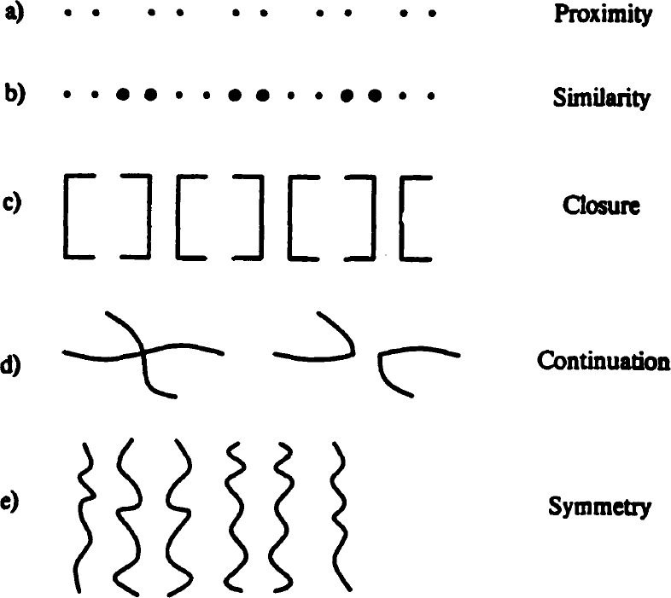
1984
Perceptual Organization and Visual Recognition, David Lowe, 1984

Slide 56
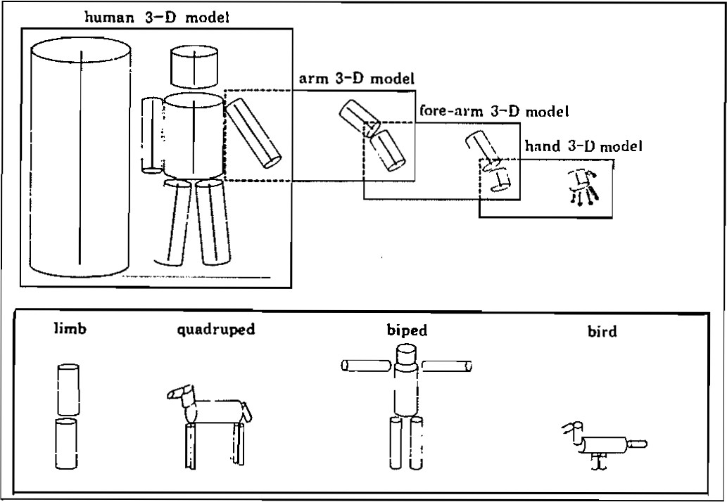
1986
Perceptual organization and the representation of natural form, Alex Pentland, 1986

Slide 57
1989
MNIST
Zip codes
Backpropagation applied to handwritten zip code recognition, Lecun et al., 1989

Slide 58
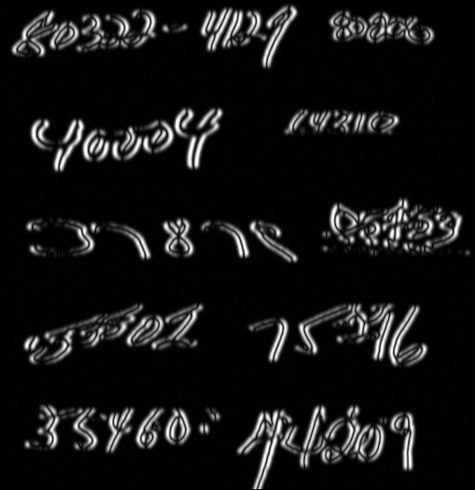
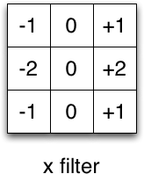
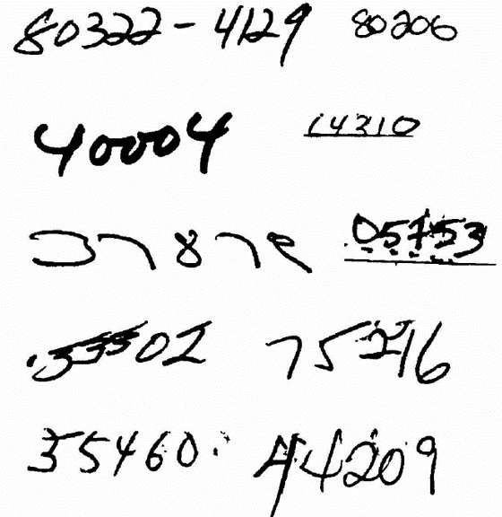
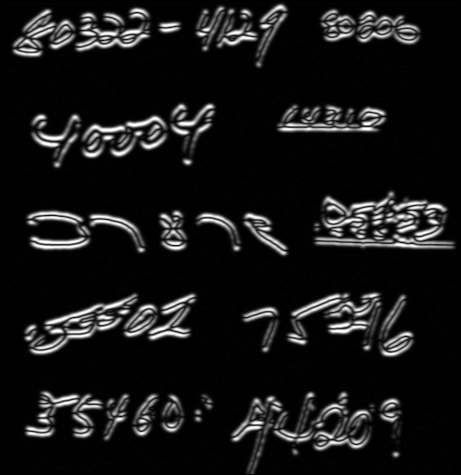
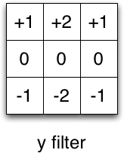
Filters
Input

Slide 59
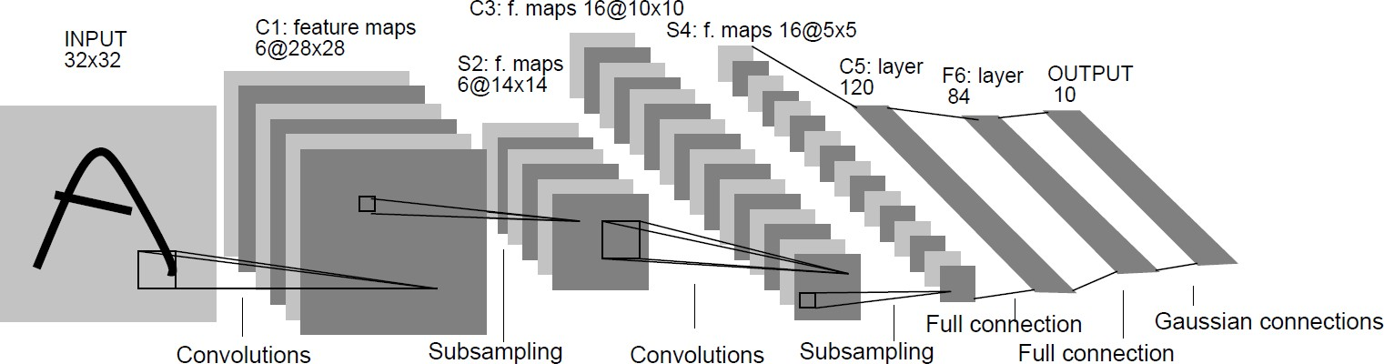
1989
Backpropagation applied to handwritten zip code recognition, Lecun et al., 1989

Slide 60

1989
Backpropagation applied to handwritten zip code recognition, Lecun et al., 1989

Slide 61
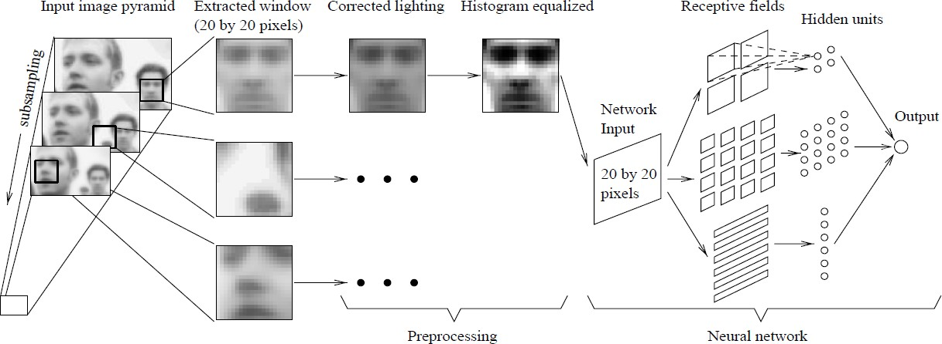
1998
Faces
Neural Network-­‐Based Face Detection, Rowley at al., PAMI 1998

Slide 62
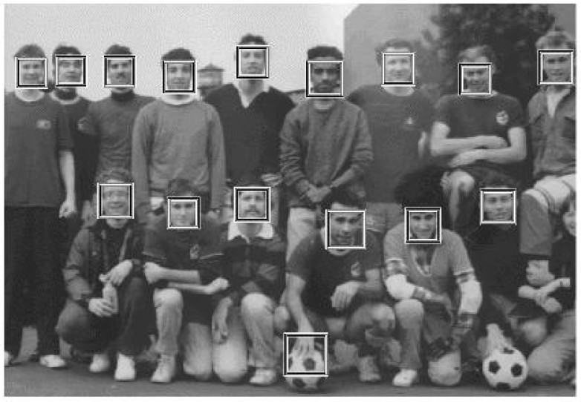
2001
Sliding window in real time!
Boosting + Cascade = Speed
Rapid Object Detection using a Boosted Cascade of Simple Features, Viola and Jones, CVPR 2001

Slide 63
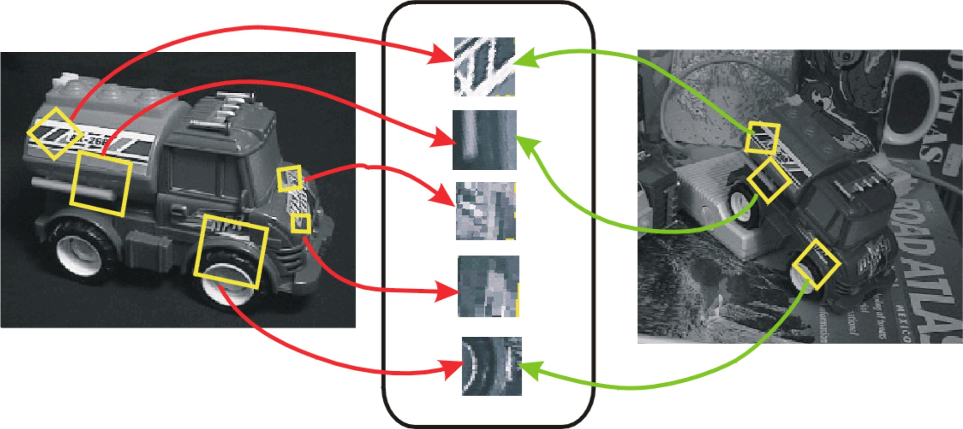
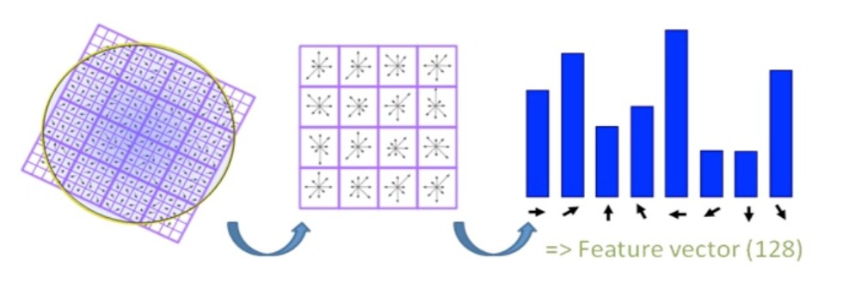
1999
SIFT
(Scale Invariant Feature Transform)
No more sliding windows (interest points) Better features (use more computation)
Object Recognition from Local Scale-­‐Invariant Features, Lowe, ICCV 1999.

Slide 64
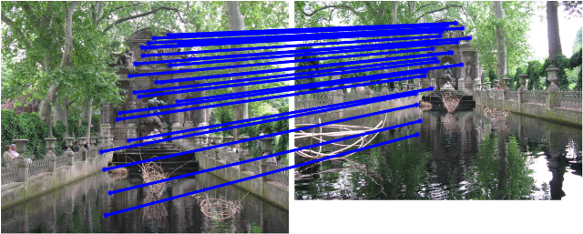
SIFT Matching
[SIFT: Lowe, 2004]

Slide 65
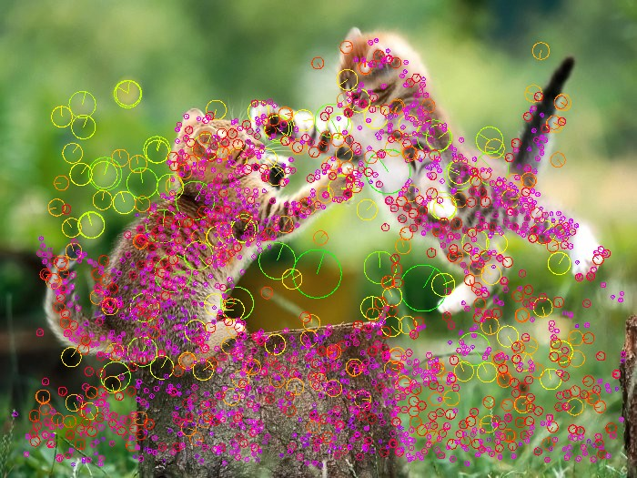
Interest points

Slide 66









2003
Constellation model (redux)
Object Class Recognition by Unsupervised Scale-­‐Invariant Learning, Fergus et al., CVPR 2003.

Slide 67
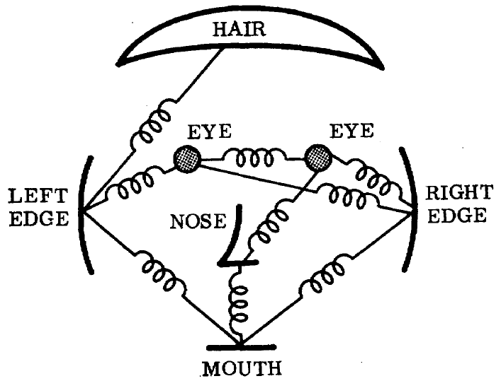
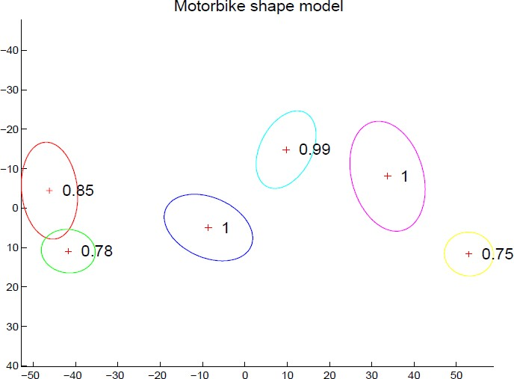
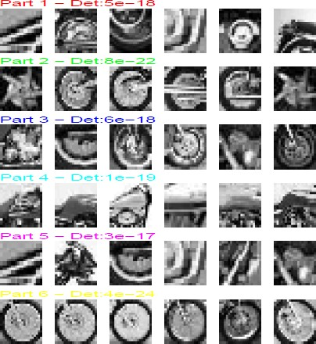
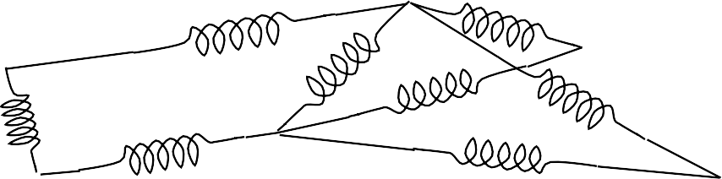
2003
Constellation model (redux)
The representation and matching of pictorial structures, Fischler and Elschlager, 1973
Joint Gaussian density

Slide 68
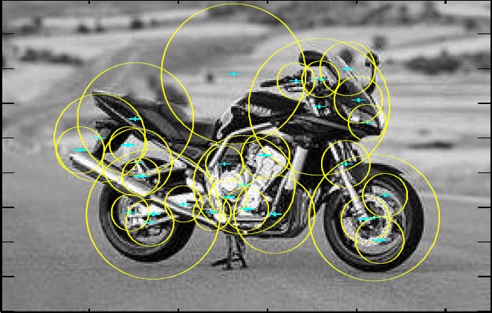
Interest points used to find parts:
Smaller number of candidate parts allows for more complex spatial models.

Slide 69
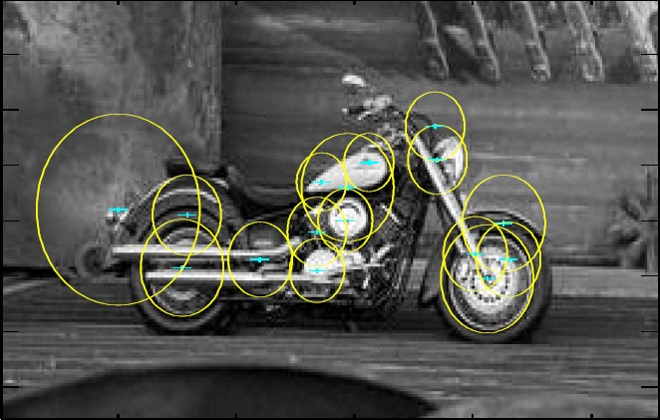
Why it fails
Interest points don’t work for category recognition

Slide 70

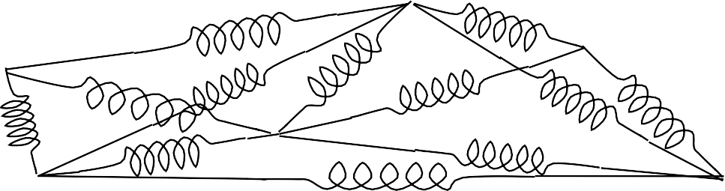
Too many springs…

Slide 71

Classification
Vs.
Detection
✓✓ Cat
Cat
Cat

Slide 72
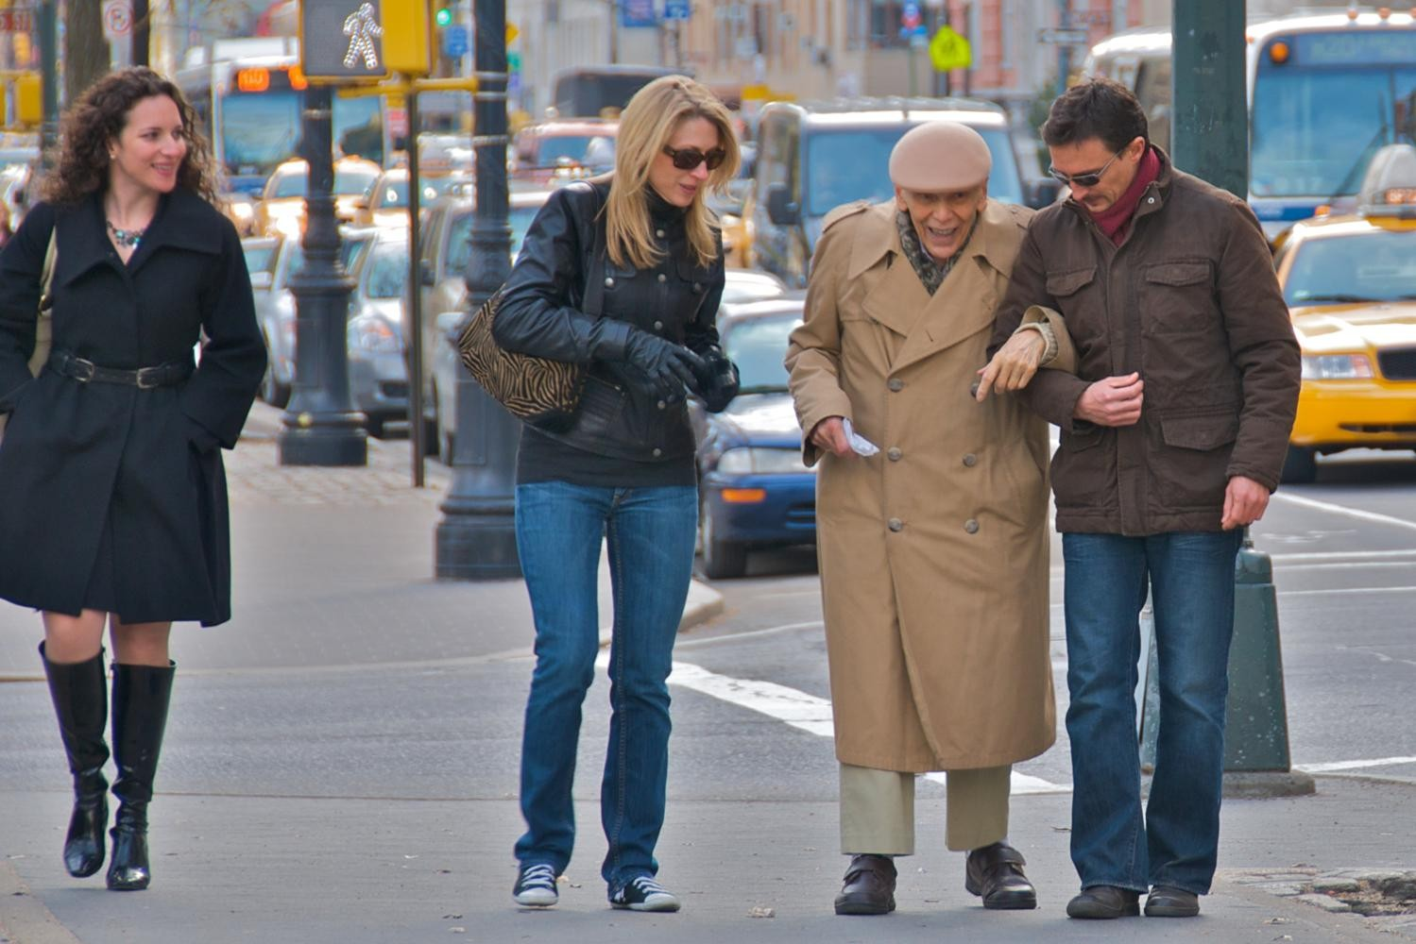
2005 HOG (histograms of oriented gradients)
Histograms of oriented gradients for human detection, Dalal and Triggs, CVPR 2005.

Slide 73

Pedestrians
Defined by their contours
Cluttered backgrounds
Significant variance in texture
Interest points won’t work…
…back to sliding window.

Slide 74


2005 HOG (histograms of oriented gradients)
SIFT

Slide 75

2005 HOG (histograms of oriented gradients)
Histograms of oriented gradients for human detection, Dalal and Triggs, CVPR 2005.

Slide 76

2005 HOG (histograms of oriented gradients)
Presence > Magnitude
✓✓ Normalization by a local window
Notes:
We can finally detect object boundaries in a reliable manner!
Hard negative mining Computers are fast enough.

Slide 77

What’s this?
[Dalal and Triggs, 2005]

Slide 78
Yup.
Image
HoG

Slide 79


2007 PASCAL VOC
20 classes
The PASCAL Visual Object Classes (VOC) Challenge, Everingham, Van Gool, Williams, Winn and Zisserman, IJCV, 2010

Slide 80





Why it is hard

Slide 81

2008 DPM (Deformable parts model)
Object Detection with Discriminatively Trained Part Based Model,
Felzenszwalb, Girshick, McAllester and Ramanan, PAMI, 2010

Slide 82

2008 DPM (Deformable parts model)
Object Detection with Discriminatively Trained Part Based Model,
Felzenszwalb, Girshick, McAllester and Ramanan, PAMI, 2010

Slide 83

Multiple components
Notes:
Multiple components
Deformable parts?
Hard negative mining
Good balance

Slide 84







Problems with Visual Categories
A lot of categories are functional
Char
World is too varied
car
Categories are 3D, but images are 2D
57

Slide 85

Do We Need More Training Data or Better Models for Object Detection?
Zhu, Vondrick, Ramanan, Fowlkes, BMVC 2012.

Slide 86


Slide 87


2009 ImageNet
22K categories, 14M images Corgi
Orb weaving spider
ImageNet: A Large-­‐Scale Hierarchical Image Database,
Deng, Dong, Socher, Li, Li and Fei-­‐Fei, CVPR, 2009

Slide 88



Images
2009
2012
14M
ImageNet

Slide 89


Categories
2009
2012
22K
ImageNet

Slide 90



Algorithms
2012
Dense
Dense
Dense
2009
Convolution
Convolution
Pooling
Convolution
SVM
Convolution
HOG
Convolution
Image
Image

Slide 91


Slide 92


Slide 93


Slide 94


Slide 95


Slide 96


Slide 97


Slide 98


Slide 99


Going beyond categorization…
“Connect a television camera to a computer and get the machine to describe what it sees.”

Slide 100

Going beyond categorization…
“Connect a television camera to a computer and get the machine to describe what it sees.”

Slide 101

Going beyond categorization…
“Connect a television camera to a computer and get the machine to describe what it sees.”

Slide 102


Going beyond categorization…

Slide 103



Slide 104
1966
“Connect a television camera to a computer and get the machine to describe what it sees.”
Marvin Minsky Turing award, 1969

Slide 105

Notes:
https://www.youtube.com/watch?v=R2mC-NUAmMk

